Slide 1
Bacchus Winery Case Study Solution
Course: CSD310
Date: May 25th, 2025
Team Members: Brennan Cheatwood, Kimberly Orozco

Slide 2

Group Introduction
We’re Brennan and Kimberly.
We worked on this project collaboratively, where no part went untouched by both of us. We oftenly(?) kept in touch and helped each other fix errors when they popped up.

Slide 3


Case Study Overview
Bacchus Winery manages employees, suppliers, wine production, inventory, and distribution.
GOALS:
Track employee hours
Manage wine inventory
Handle supplier info and supply deliveries
Fulfil distributor orders
Have helpful business reports

Slide 4

Business Rules (Summary)
Employees belong to specific departments and log hours
Orders include order date, shipping date, and delivery status
Four wines produced: Merlot, Cabernet, Chablis, and Chardonnay
Each department has one manager
Supplies are tied to suppliers and tracked with delivery dates
Distributors can order any wine in stock

Slide 5

Assumptions (Summary)
Employees only belong to one department
Supply deliveries go straight to the winery
Wines are tracked by how much is made and sent out (not by batch)
Distributors are in charge of picking up and delivering wine orders
Suppliers are contacted manually, not through an online system
Distributors can use the system to order and check delivery updates

Slide 6
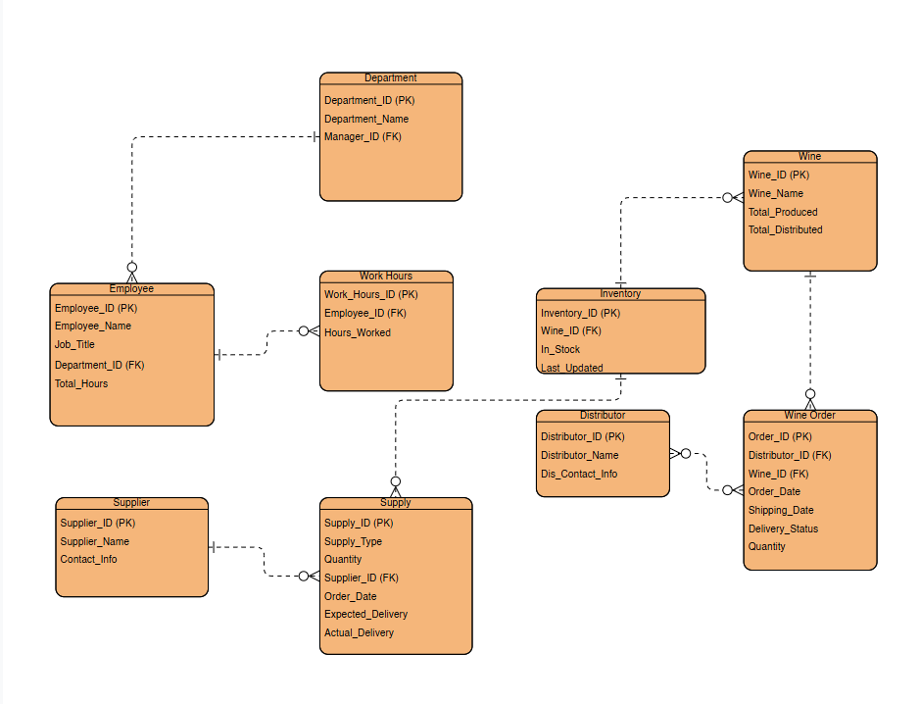
Final ERD
Our final ERD here shows how Bacchus Winery keeps track of everything like employees, wine, suppliers, and orders. It connects employees to departments and work hours, also tracking wine production and inventory. Everything is linked to help Bacchus Winery run smoothly!
Can you put the final ERD picture here U_U
Why yes of course.

Slide 7
Reports We Created
Here are some reports we thought would help Bacchus Winery:
Report 1: Wine Production vs Distribution
Report 2: Employee Hours by Department
Report 3: Supply Orders and Delivery Timeliness

Slide 8
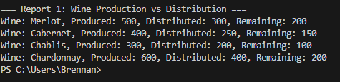
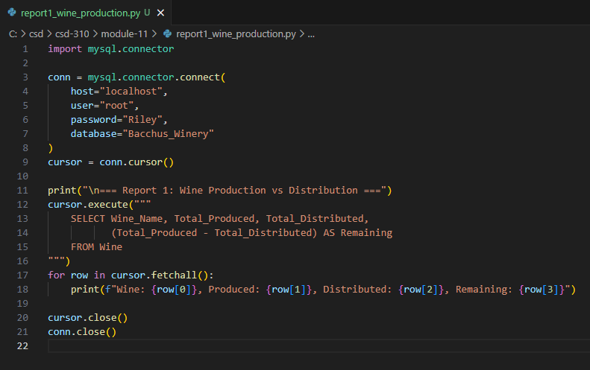
Report 1 - Wine Production vs Distribution
Output
This is a simple comparison between wine produced and how much is being distributed. There is also a tab showing the remaining supply after distribution.
Code

Slide 9
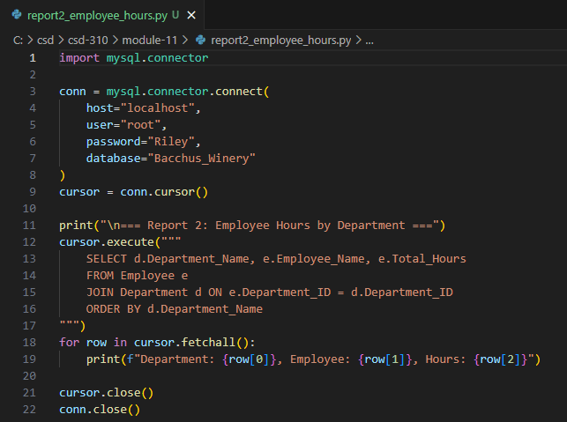
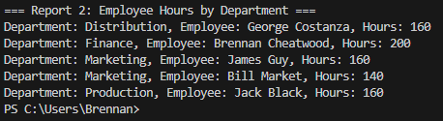
Report 2 - Employee Hours by Department
This report simply shows the allocated monthly hours towards each department’s employee.
Output
Code

Slide 10

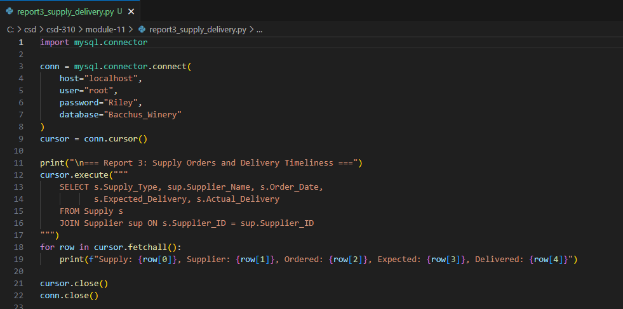
Report 3 - Supply Orders & Delivery Timeliness
This report shows which supplies have been ordered, and the vendor. Along with that, it shows when the order was placed, along with when it was expected, and when it actually arrived.
Output
Code

Slide 11
Final Thoughts
We built a working database that follows Bacchus Winery’s rules.
It keeps track of all their main business info and gives helpful reports.
We tried to keep it flexible so it can grow and be improved later as Bacchus Winery grows as a business!

